Slide 1
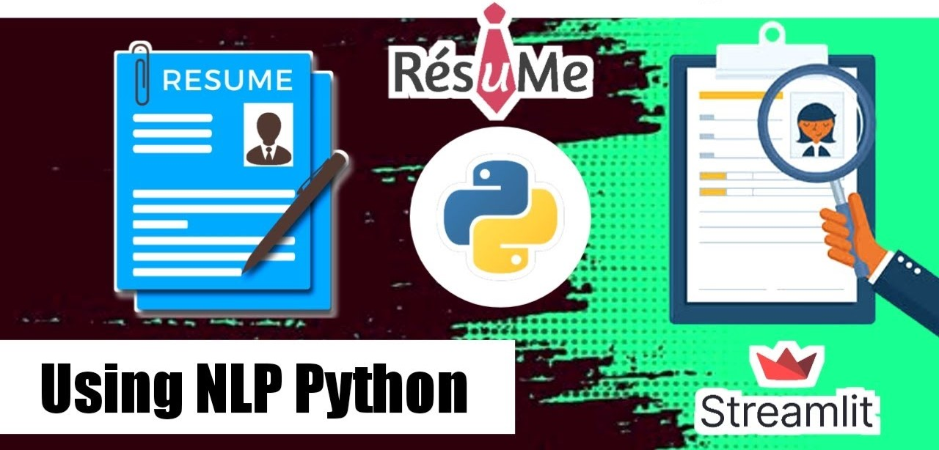

Slide 2
Resume Classification Analysis

Slide 3
Business Problem
The document classification solution should significantly reduce the manual human effort in the HRM. It should achieve a higher level of accuracy and automation with minimal human.
Objective
The objective of a resume classification project typically involves automating the process of categorizing resumes into different job roles, industries, or skill sets. This can streamline the hiring process for recruiters and HR departments by enabling them to quickly identify the most relevant resumes from a large pool of applicants.

Slide 4
Abstract
A resume is a brief summary of your skills and experience. Companies recruiters and HR teams have a tough time scanning thousands of qualified resumes. Spending too many labor hours segregation candidates resume’s manually is a waste of a company’s time, money, and productivity . Recruiters , therefore, use resume classification in order to streamline the resume and applicant screening process. NLP technology allows recruiters to electronically gather, store, and organize large quantities of resumes. Once acquires, the resume data can be easily searched through and analyzed.
Resumes are an ideal example of unstructured data. Since there is no widely accepted resume layout, each resume may have its own style of formatting, different text blocks and different category titles. Building a resume classification and gathering text from it is no easy task as there are so many kinds of layouts of resumes that you could imagine.

Slide 5
Introduction
In this project we dive into a Machine Learning Models for Resume Classification using Python and basic Natural Language Processing techniques. We would be using Python’s Libraries to implement various NLP(natural language processing) techniques like tokenization, lemmatization, part of speech tagging etc..
The organizations face the challenging task of sifting through thousands of resumes for a single job opening. This process is not only labor-intensive but also prone to human error and bias. As a result, valuable candidates might be overlooked, and the recruitment process can become inefficient and inconsistent.
The basic data analysis process is performed such as data collection, data cleaning , exploratory data analysis, data visualization, and model building. The dataset consists of two columns, namely, Role applied and Resumes, where “role applied” columns is the domain field of the industry and “resume” columns consists of the text extracted from the resume document for each domain and industry.
The Aim of this project is achieved by performing the various data analytical methods and using the Machine Learning Models and Natural Language Processing which will help in classifying the categories of the resume and building the Resume Classification Model.

Slide 6
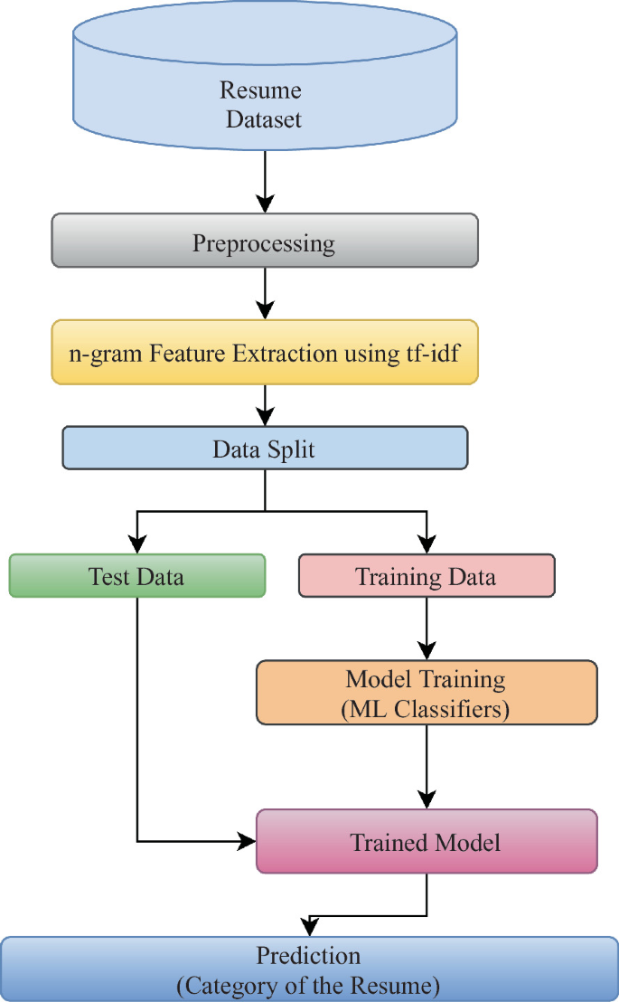
Project Flow CharT
Introduction
Objective
Text Mining
Exploratory Analysis
Data Preprocessing
Model Building
Model Evaluation
Deployment

Slide 7
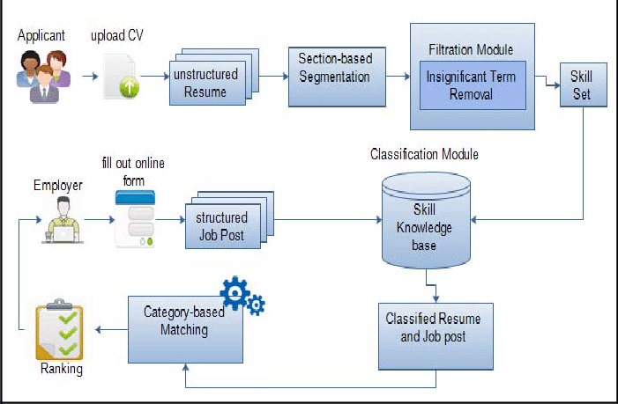
Resume Classification Architecture

Slide 8
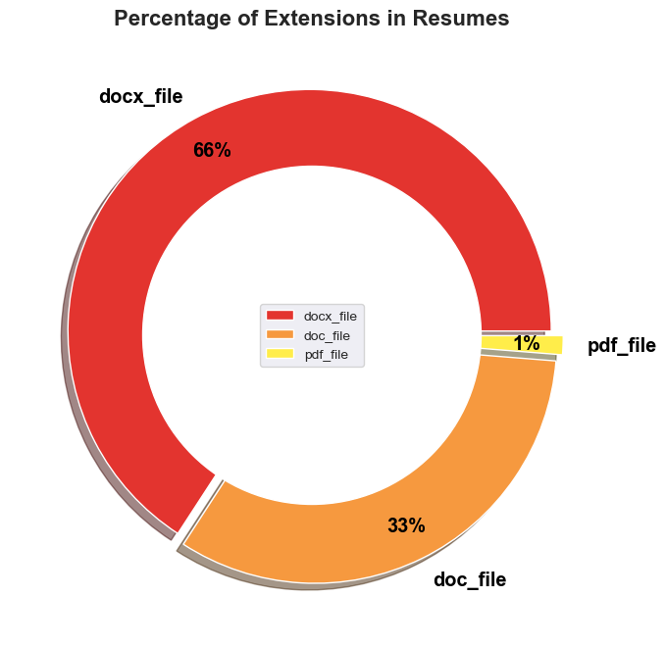
Documents Files present in out dataset:

Slide 9
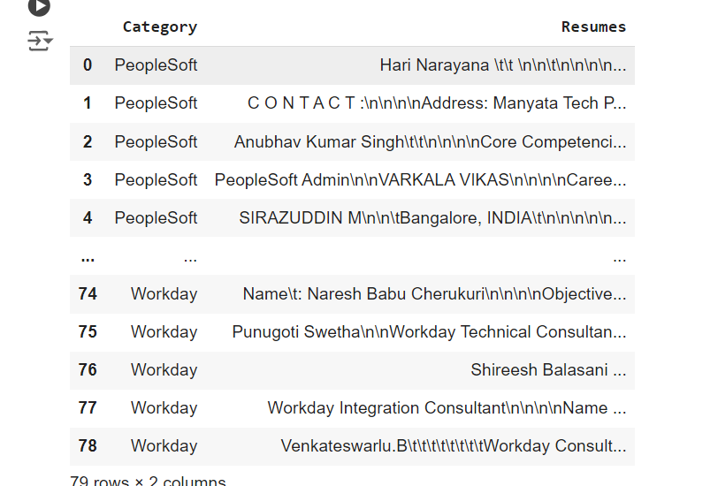
DataSet

Slide 10
Exploratory Data Analysis
Exploratory Data Analysis (EDA) refers to the method of studying and exploring record sets to apprehend their predominant traits, discover patterns, locate outliers, and identify relationships between variables. EDA is normally carried out as a preliminary step before undertaking extra formal statistical analyses or modeling.
The Foremost Goals of EDA
Data Cleaning
Descriptive Statistics
Data Visualization
Outlier Analysis and Handling

Slide 11
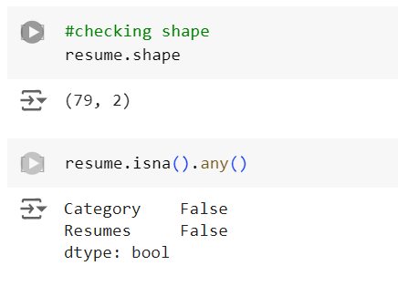
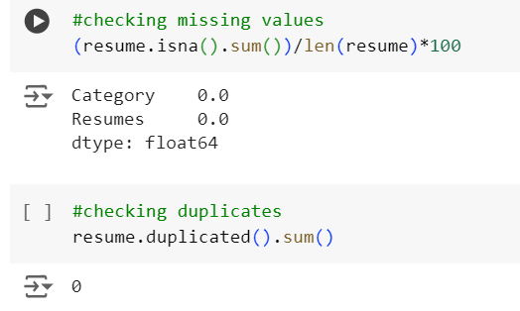
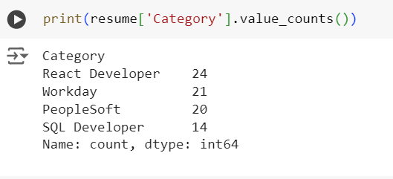

Slide 12
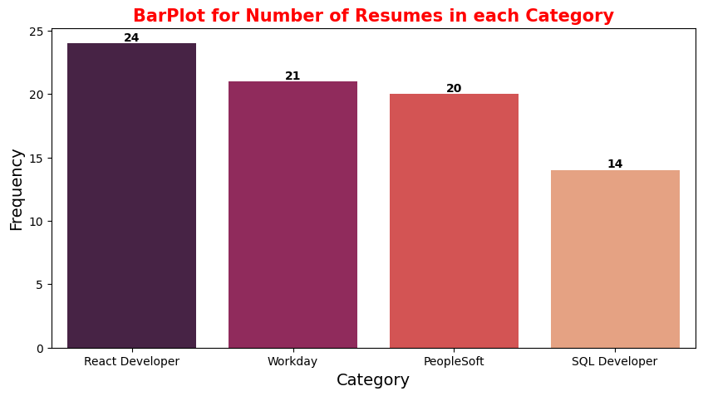
Visualization
Visualization showing all character of resume present in the document

Slide 13
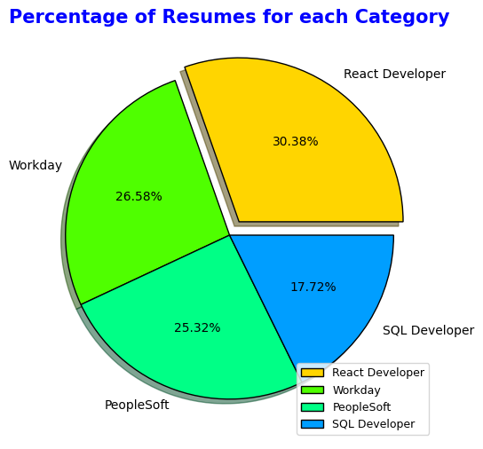
% of data present in the document

Slide 14
EDA
NUMBER OF CHARACTER
NUMBER OF WORD IN EACH RESUME
NUMBER OF NUMERIC
NUMBER OF STOPWORDS

Slide 15
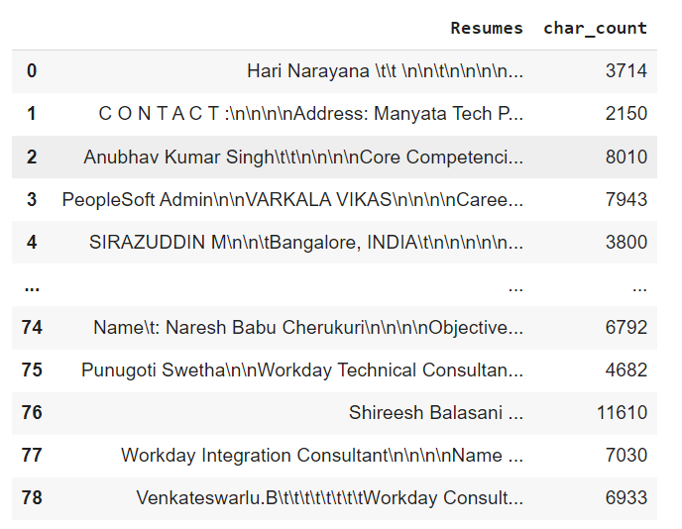
Number of Character

Slide 16
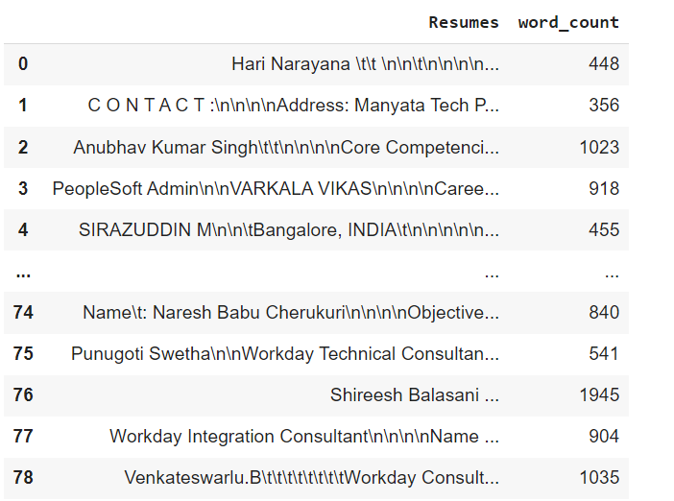
Number of words in each resume

Slide 17
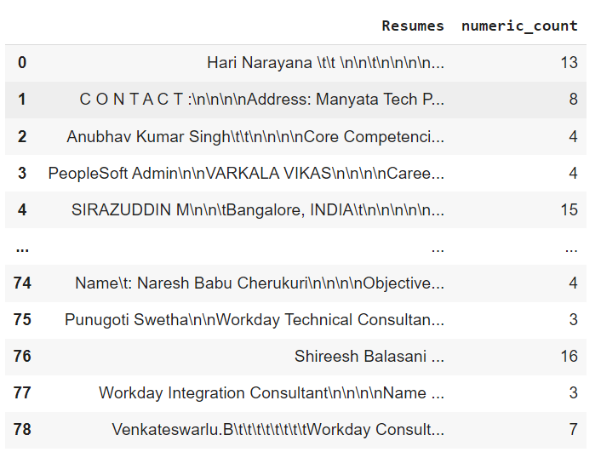
Number of Numerics

Slide 18
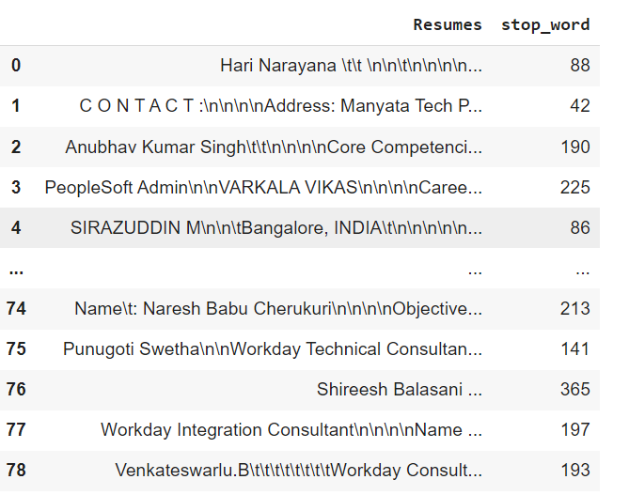
Number of StopWords

Slide 19
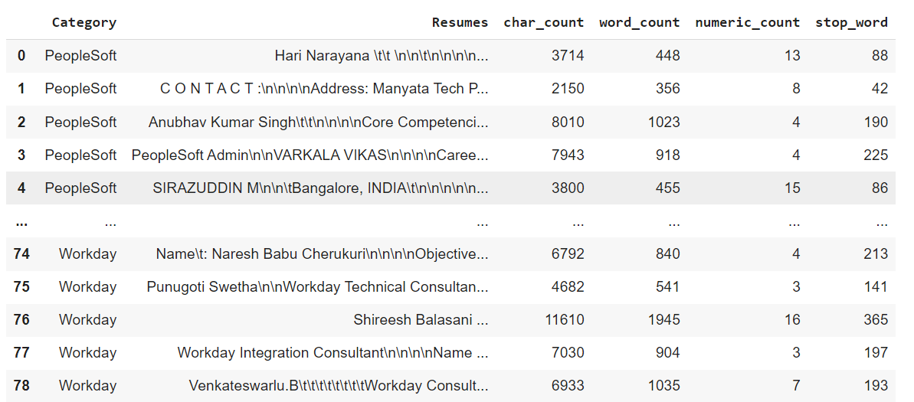

Slide 20
Text PreProcessing
Text preprocessing is an essential step in natural language processing (NLP) that involves cleaning and transforming unstructured text data to prepare it for analysis. It includes tokenization, stemming, lemmatization, stop-word removal, and part-of-speech tagging.
Apart from numerical data, Text data is available to a great extent which is used to analyze and solve business problems. But before using the data for analysis or prediction, processing the data is important.
To prepare the text data for the model building we perform text preprocessing. It is the very first step of NLP projects. Some of the preprocessing steps are:
Removing punctuations like . , ! $( ) * % @
Removing URLs
Removing Stop words
Lower casing
Tokenization
Stemming
Lemmatization

Slide 21
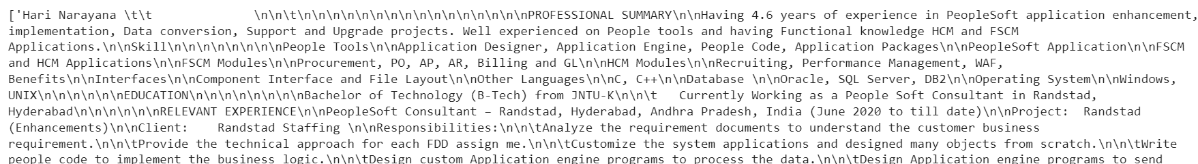
Before
AFTER

Slide 22
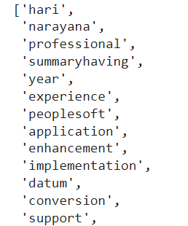
After Complete Tokenization

Slide 23
Feature Extraction
Feature Extraction Techniques in Machine Learning algorithms learn from a pre-defined set of features from the training data to produce output for the test data. But the main problem in working with language processing is that machine learning algorithms cannot work on the raw text directly. So, we need some feature extraction techniques to convert text into a matrix(or vector) of features. Some of the most popular methods of feature extraction are
Bag-of-Words or Count Vectorizer
TF-IDF Vectorizer
PCA(Principal Component Analysis)

Slide 24
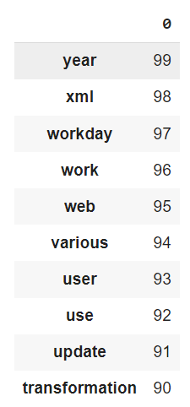
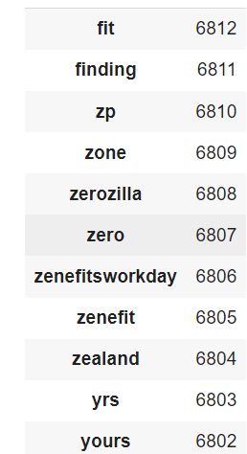
Count Vectorizer
TF-IDF Vectorizer
Top 10 words
Top 10 words

Slide 25
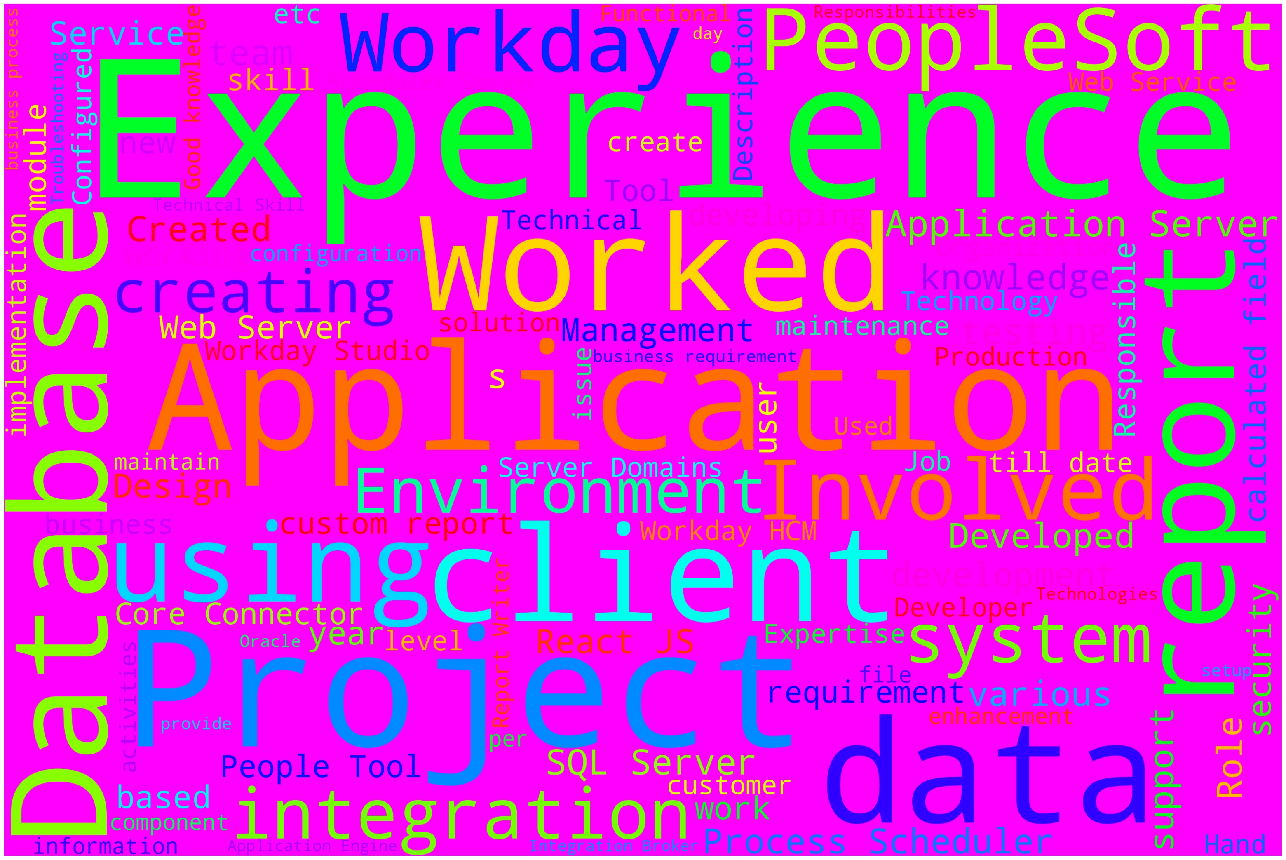
Word Cloud

Slide 26
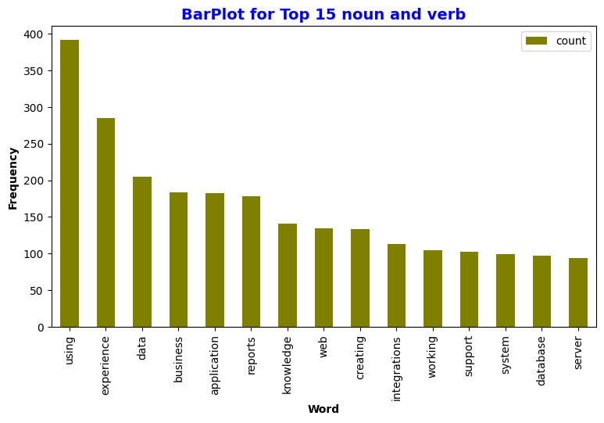
Top 10 most common words

Slide 27
Feature Engineering
Feature engineering is a machine learning technique that leverages data to create new variables that aren't in the training set. It can produce new features for both supervised and unsupervised learning, with the goal of simplifying and speeding up data transformations while also enhancing model accuracy.
Label Encoding
Train-Test Split
TF-IDF Vectorizer

Slide 28
Model Building Algorithms
List of Models Using for Model Building
Logistic Regression
DecisionTree Classifier
KNN Classifier
SVM Classifier
NaiveBayes Classifier
RandomForest Classifier
Bagging Classifier
AdaBoost Classifier
Gradient Boosting Classifier
Voting Classifier

Slide 29
Model Evaluation
SNO | Models | Accuracy(%) | Training Accuracy(%) | Testing Accuracy(%) | Precision(%) | Recall(%) | F1_score(%)
1. | Logistic Regression | 1.00 | 1.00 | 1.00 | 1.00 | 1.00 | 1.00
2. | DecisionTree Classifier | 0.88 | 1.00 | 0.88 | 0.92 | 0.89 | 0.89
3. | KNN Classifier | 0.92 | 0.89 | 0.92 | 0.94 | 0.88 | 0.89
4. | SVM Classifier | 0.79 | 1.00 | 0.79 | 0.65 | 0.71 | 0.66
5. | NaiveBayers | 0.88 | 1.00 | 0.88 | 0.92 | 0.81 | 0.81
6. | RandomForest Classifier | 0.96 | 1.00 | 0.96 | 0.97 | 0.96 | 0.96
7. | Bagging Classifier | 0.96 | 1.00 | 0.96 | 0.97 | 0.94 | 0.95
8. | AdaBoost Classifier | 0.92 | 1.00 | 0.92 | 0.92 | 0.92 | 0.91
9. | GradientBoosting | 0.96 | 1.00 | 0.96 | 0.95 | 0.96 | 0.95
10. | Voting Classifier | 1.00 | 1.00 | 1.00 | 1.00 | 1.00 | 1.00

Slide 30
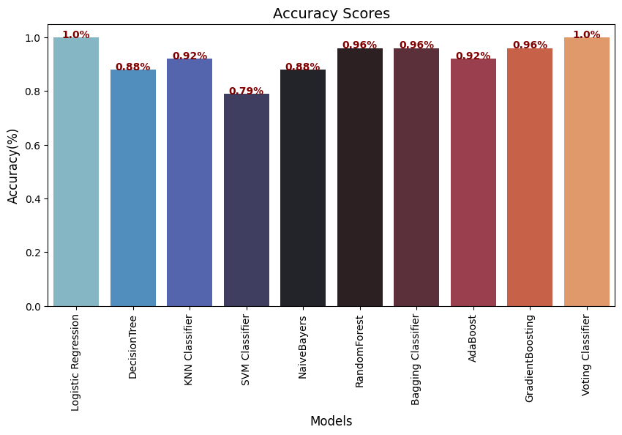
Accuracy Score

Slide 31
Final Model
RandomForest Classifier Model is giving good accuracy score and other value scores
So let us consider “RandomForestClassifier” for our final model building
RandomForest Accuracy Score:96.0%
RandomForest Training Accuracy Score:100.0%
RandomForest Testing Accuracy Score:96.0%

Slide 32
Model Deployment
Deployment using Streamlit
STREAMLIT IS A FREE AND OPEN-SOURCE FRAMEWORK TO RAPIDLY BUILD AND SHARE BEAUTIFUL MACHINE LEARNING AND DATA SCIENCE WEB APPS. Its is a python-based library specifically designed for machine learning engineers. Streamlit allows you to create a stunning-looking application with only a few lines of code.

Slide 33
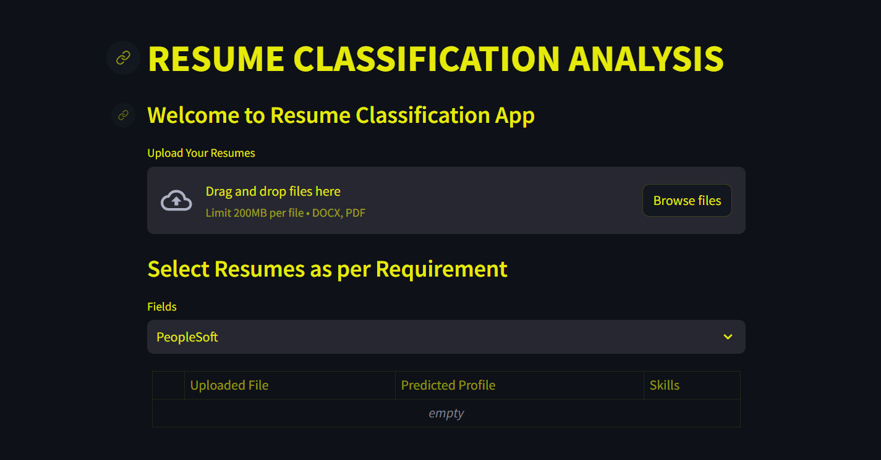
Final Web Page

Slide 34
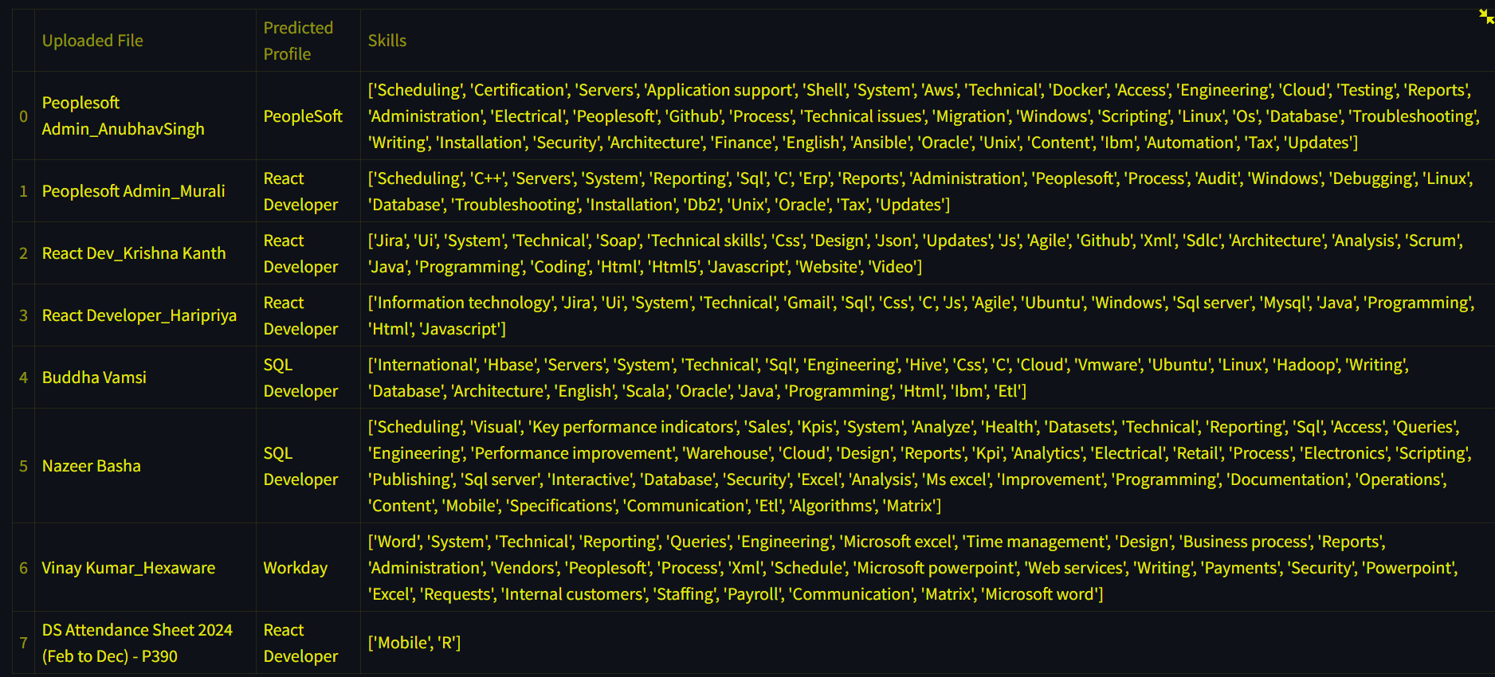

Slide 35
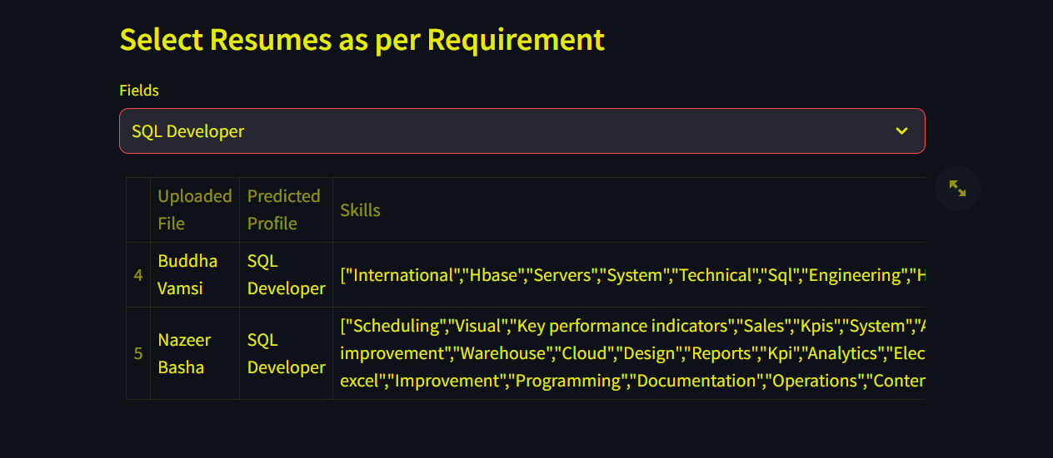

Slide 36
Challenges
1.Data Variability:
Format Differences: Resumes come in various formats (PDF, Word, text, HTML) and structures, making it hard to standardize the input data.
Unstructured Data: Resumes often contain unstructured data, mixing free-text descriptions with structured sections like education and experience, complicating extraction and classification.
2.Information Extraction:
Named Entity Recognition (NER): Identifying and categorizing entities such as names, dates, job titles, and organizations can be challenging, especially with variations and abbreviations.
Context Understanding: Distinguishing between similar terms used in different contexts requires deep contextual understanding.

Slide 37


